Slide 1

“Crypto Crystal Ball: Using Machine Learning to Forecast the Price of Trending Digital Currencies”
Guided By:
Mr. Tushar Kute
Ms Trupti Joshi
Submitted By:
Anisha Gupta (220943025006)
Raunak Mudgal (220943025032)
11/03/23
1

Slide 2

Outline:
Introduction of Team and Project
Objective
Problem Statement
Overview of Tools Used
About Dataset
Data Preprocessing
Data Cleaning
Data Visualization & Representation
Machine Learning Algorithms
Accuracy Achieved
Conclusion and Future Scope
11/03/23
2

Slide 3
INTRODUCTION:
A cryptocurrency is a digital currency, which is an alternative form of payment created using encryption algorithms. The use of encryption technologies means that cryptocurrencies function both as a currency and as a virtual accounting system. To use cryptocurrencies, you need a cryptocurrency wallet
Cryptocurrency such as Bitcoin are more popular these days among investors.
To predict the bitcoin price accurately, firstly , we identify the daily trends in the bitcoin price while gaining insight into the optimal features surrounding the bitcoin price. Secondly, using the available information, we will predict the sign of the daily price change with highest possible accuracy.
Data used in the project is structured in nature from year 2020.1 to 2021.5. It was collected from www.kaggle.com. To assess the accuracy of the developed prediction model and identify ways to improve its performance.This research uses Decision Tree Regressor, Random Forest Regressor, GBT Regressor, Linear Regression and K-Means.
11/03/23
3
Notes:
Hive and Hive QL statements have been used for querying the data.
For future scope, various different Machine Learning algo0rithm will be implemented on different flight delay datasets.

Slide 4

Objectives of Project:
To identify the most important features or factors that affect the price of cryptocurrencies and incorporate them into the prediction model.
To test the prediction model on historical data and assess its performance using metrics such as root mean square error.
11/03/23
4

Slide 5
Overview of tools used and their role in the project:
PYTHON
We have used the Python programming language to build our project. Using various libraries of python we have created interactive graph and interface. The algorithms of machine learning are build using pyspark library.
TABLEAU
For data visualization we have used Tableau Public. Using this we created various graph of the features.
Pyspark
PySpark is an interface for Apache Spark in Python. It not only allows you to write Spark applications using Python APIs, but also provides the PySpark shell for interactively analyzing your data in a distributed environment. PySpark supports most of Spark’s features such as Spark SQL, DataFrame, Streaming, MLlib (Machine Learning) and Spark Core.

Slide 6
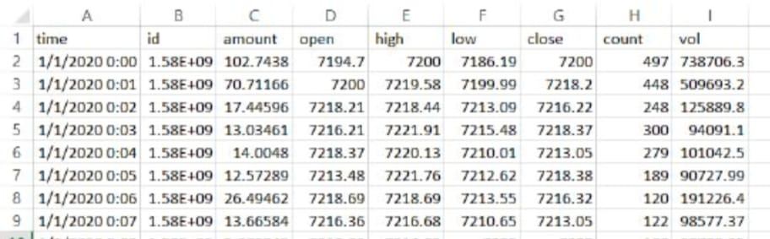
About Dataset

Slide 7
Datasetime: Beijing time
ID: UTC timestamp
Amount: trading amount
Count: num of transactions
Open: open price in usdt
Close: close price in usdt
Low: lowest price in usdt
High: highest price in usdt
Vol: volume of transactions
usdt: US Dollar

Slide 8
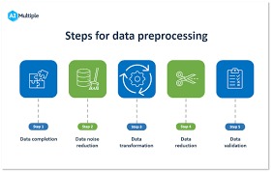
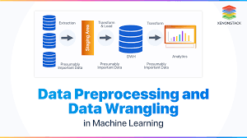
Data Pre-Processing:
Missing values
Missing values in the type of delay columns are being dropped, indicating the cause is not valid.
Although, there are no null values in our data.
11/03/23
8

Slide 9
Data Cleaning Operations:
To check null values with Mean, Mode and Median depend upon the type of values.
To replace the null feature. We have imported the timestamp function from pyspark sql functions and we have made the time column in the timestamp datatype and after that we have extracted the year, month and date seperately with the Column function of the pyspark sql functions.

Slide 10
Data Visualization
We used tableau as our data visualization tool in our project.
In which, we plotted column attributes per day and weekly forecast on it
Such as,

Slide 11
Data Visualization:
1.Amount - Per Day Forecast
2.Open (Price) - Per Day Forecast
3.Close (Price) - Per Day Forecast
4.High - Per Day Forecast
5.Low - Per Day Forecast
6.Volume - Per Day Forecast

Slide 12
Data Visualization
1.Amount – Weekly Forecast
2.Open (Price) – Weekly Forecast
3.Close (Price) - Weekly Forecast
4.High - Weekly Forecast
5.Low - Weekly Forecast
6.Volume - Weekly Forecast

Slide 13
Analyzing Historical Bitcoin Prediction with Current Bitcoin Amout Price
By referring to our predicted past dataset we perform some data visualization
Work on by using tableau as a tool .
And Analyzing it with current Bitcoin Amount Price and conclude that what are the differences and similarties between both of them have.

Slide 14
Machine Learning Algorithms:
1. Random Forest Regressor :
Ensemble of decision trees: Random Forest Regressor is an ensemble learning method that combines multiple decision trees to produce a more accurate prediction. Each decision tree in the forest is trained on a randomly sampled subset of the training data and a subset of the input features. The final prediction is the average of the predictions of all the trees in the forest.
2. Decision Tree Regressor :
Decision Tree Regressor is a machine learning algorithm that uses a decision tree to predict continuous numerical values. In Apache Spark's Machine Learning Library (MLlib), you can use the Decision Tree Regressor algorithm to build a decision tree model.
Decision Tree Regressor is a machine learning algorithm that uses a decision tree to predict continuous numerical values.
11/03/23
14

Slide 15
3. GBT Regressor
The most important hyperparameters of the GBT Regressor algorithm are the maximum depth of the tree (maxDepth), the maximum number of iterations (maxIter), the learning rate (stepSize), and the fraction of the dataset used for each iteration (subsampleRate). You can tune these hyperparameters to optimize the performance of the algorithm.
4. Linear Regression
Linear regression uses the relationship between the data-points to draw a straight line through all them. This line can be used to predict future values. In the most simple words, Linear Regression is the supervised Machine Learning model in which the model finds the best fit linear line between the independent and dependent variable i.e it finds the linear relationship between the dependent and independent variable.
5. K Means
K-Means clustering is a popular unsupervised machine learning algorithm for clustering data. The algorithm works as follows to cluster data points: First, we define a number of clusters, let it be K here. Randomly choose K data points as centroids of the clusters.
11/03/23
15

Slide 16
Accuracy Achieved
Algorithms Used | Root Mean Squared Error
Decision Tree Regressor | 628.423
Random Forest Regressor | 773.024
GBT Regressor | 444.304
Linear Regression | 15.2454
K-Means Clustering | 27720.4

Slide 17
Conclusion and Future Scope
Our project presented a new machine learning bitcoin price prediction model that combined
and implemented machine learning algorithms and generated and predicted a model.
To improve the prediction performance, an optimal feature selection process
is introduced and demonstrated to have better performance than directly using all the
features of available datasets.
11/03/23
17

Slide 18
Linear regression models can be well-suited to data sets that exhibit a linear trend or have a small number of predictors.
Whereas, Decision Tree regressor, K-means, GBT regressor, and Random Forests are all more complex models that can be better suited to datasets with more complex relationships between variables or larger numbers of predictors. However, these models may require more tuning and optimization to achieve optimal performance, and they can be more difficult to interpret and understand than linear regression models.
It's possible that linear regression models were found to be more accurate and have lower Root Mean Square Error.

Slide 19
Thank You!

